Slide 1

Finding the Ideal Location for a Mexican Restaurant in Boston, using k-Means Clustering
IBM applied data science Capstone project
Paris charitatos

Slide 2
Introduction/Business Problem
A client wants to open a brand-new Mexican restaurant in Boston
The location of a restaurant can be crucial for its success.
The location of a restaurant can be determined by many factors:
Per Capita Income
Accessibility
Competition

Slide 3
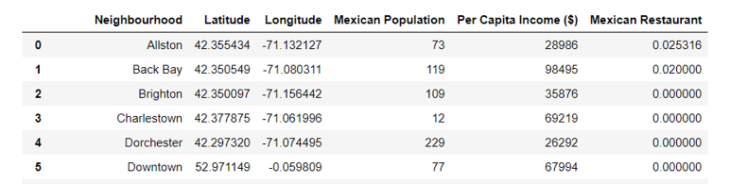
Data Acquisition and Cleaning
Data about Boston neighborhoods here
Total population
Mexican population
Per Capita Income
Obtain venues and Mexican restaurants in the area by using Foursquare’s API
A .csv file was imported and converted into a pandas data frame
Coordinates of neighborhoods were imported using geopy library
Rows with null values were erased

Slide 4
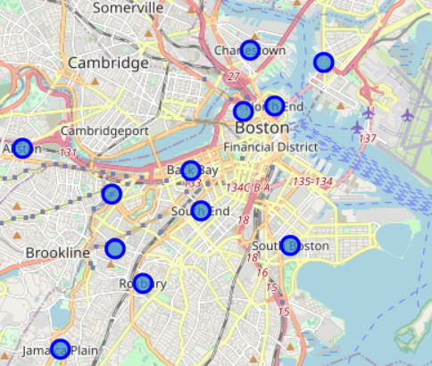
Exploratory Data Analysis
Using the folium library, a map of Boston was created, and each neighborhood was visualized with a blue marker.

Slide 5
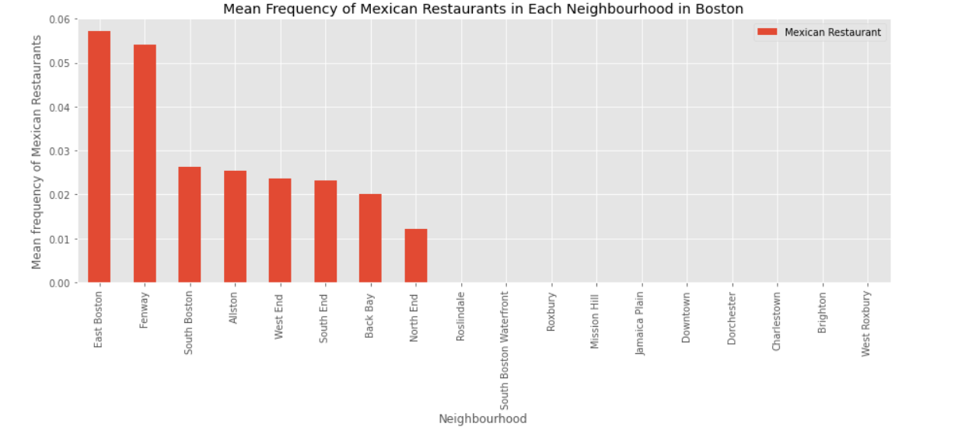
Mexican Restaurants in Each Neighborhood

Slide 6
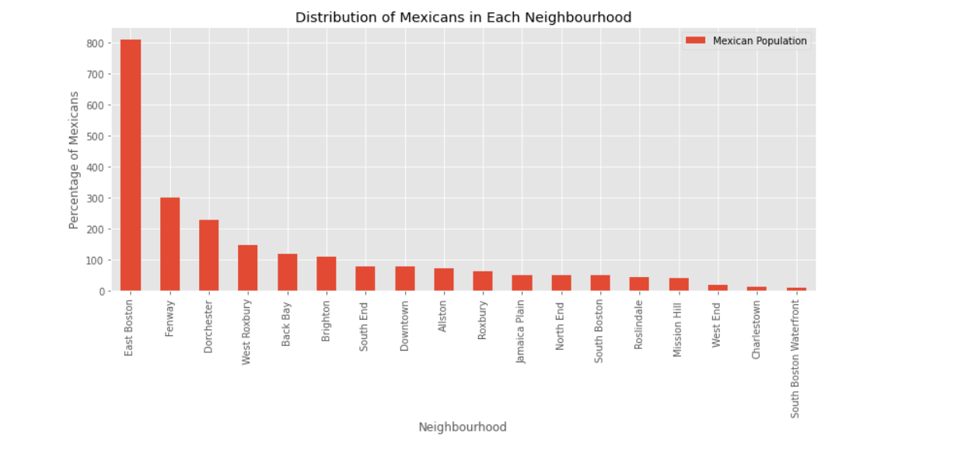
Distribution of Mexicans in Each Neighborhood

Slide 7
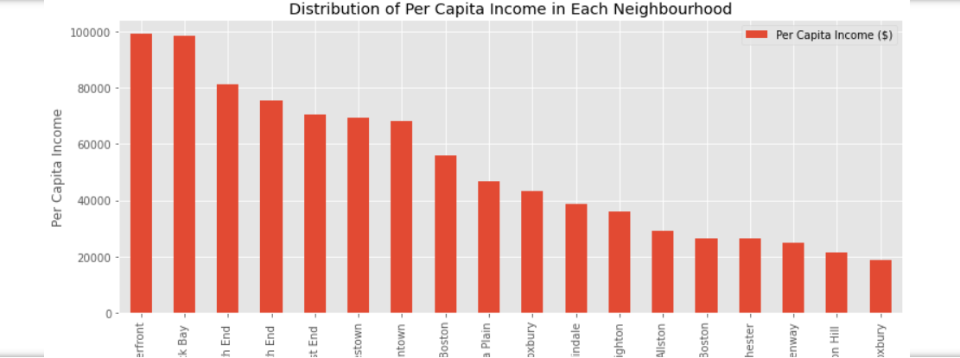
Distribution of Per Capita Income in Each Neighborhood

Slide 8
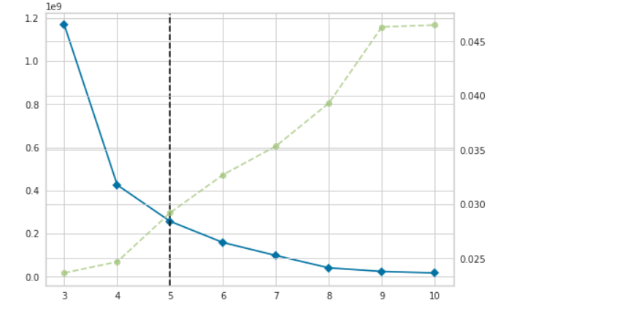
K-Means Clustering
Find the optimal number of clusters using the elbow method
5 clusters will be made

Slide 9
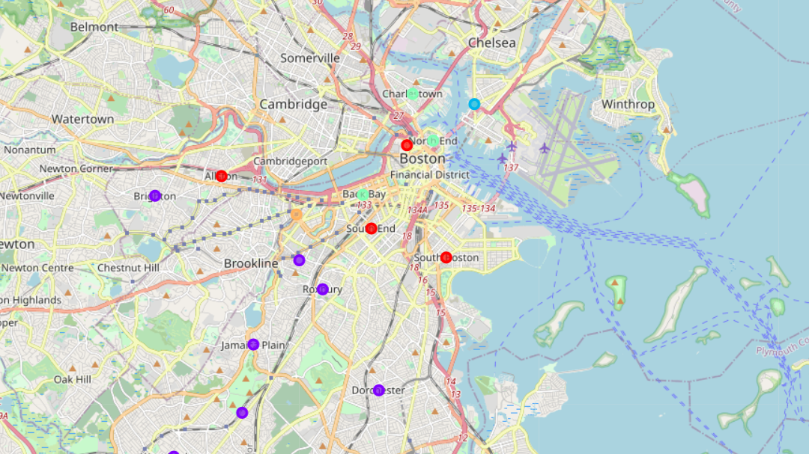
Mapping the clusters

Slide 10
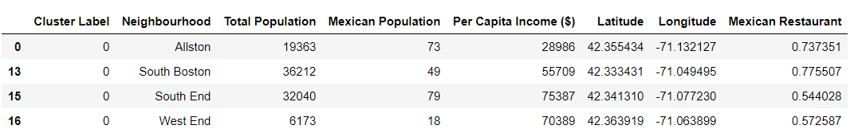
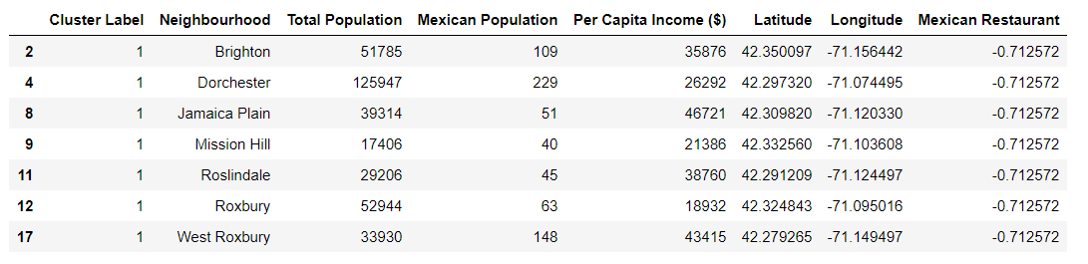
Results
Cluster 0: Many Mexican restaurants, medium income and low Mexican population
Cluster 1: High population of Mexicans, low competition and income

Slide 11
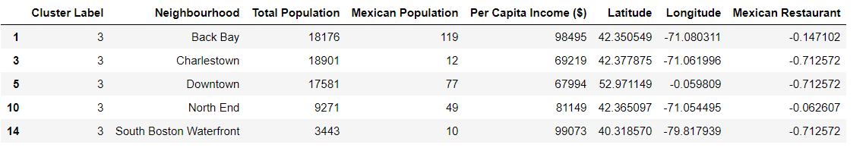
Results
Cluster 2: Many Mexican restaurants, low income and high Mexican population
Cluster 3: Low population of Mexicans, low competition and high income

Slide 12
Results
Cluster 4: Numerous Mexican restaurants, low income and medium Mexican population

Slide 13
Discussion
The ideal location for a Mexican restaurant depends a lot on the target group that the stakeholders have
If the restaurant offers food for a low-normal price, then Cluster 2 and Cluster 4 would be very good alternatives
If stakeholders plan to open a restaurant that offers pricy Mexican food, then probably cluster 0 would be the first option
High competition
Increased demand
Might be difficult to set a brand-name
Wealthy neighborhoods
Average competition
Easy to set a brand-name

Slide 14
Conclusion
Concluding this report, we could presume that this model or this methodology could be used for similar projects that concern new businesses. It is essential to mention that the model could be improved with more accurate data.
The model has some room for improvement as it could consider the style of the Mexican restaurants that already existed in each neighborhood.
In that way we could measure the competition more precisely and have a more clear option for the final location of the Mexican restaurant.
Fine dining
Take away

